Slide 1
NVIDIA TensorRT
NVIDIA 开发者社区 何琨

Slide 2
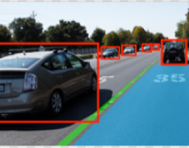
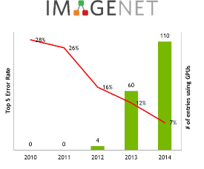









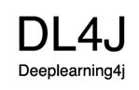









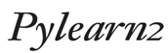



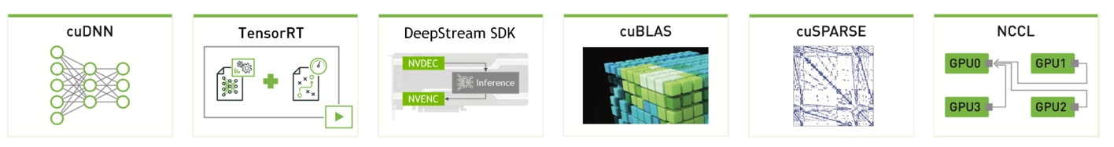
Powering the Deep Learning Ecosystem
COMPUTER VISION
SPEECH & AUDIO
NATURAL LANGUAGE PROCESSING
OBJECT DETECTION
IMAGE CLASSIFICATION
VOICE RECOGNITION
LANGUAGE TRANSLATION
RECOMMENDATION ENGINES
SENTIMENT ANALYSIS
DEEP LEARNING FRAMEWORKS
Mocha.jl
NVIDIA DEEP LEARNING SDK
developer.nvidia.com/deep-learning-software

Slide 3
Inference with TensorRT
Introduction of TensorRT
TensorRT 7: What’s New
TensorRT workflow
TensorRT Plugin
Plugin Sample

Slide 4
TensorRT: GPU Inference Engine

Slide 5

















A Complete DL Platform
MANAGE
TRAIN
DEPLOY
DIGITS
GPU INFERENCE ENGINE
TEST
TRAIN
MANAGE / AUGMENT
EMBEDDED
DATA CENTER
AUTOMOTIVE

Slide 6
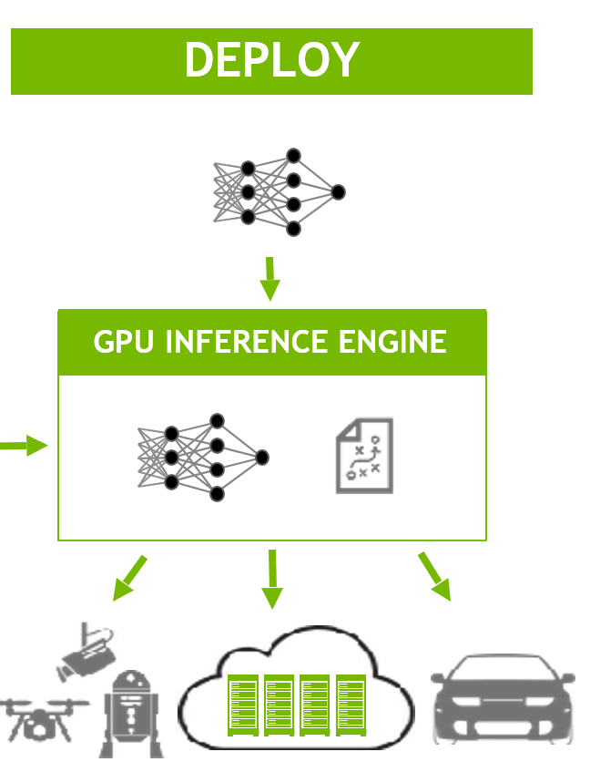
TensorRT works at deploy stage

Slide 7
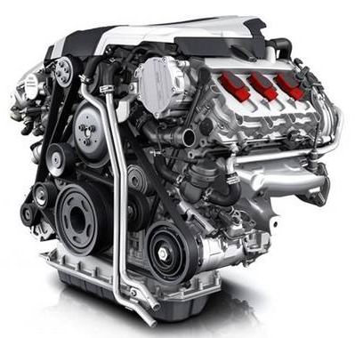
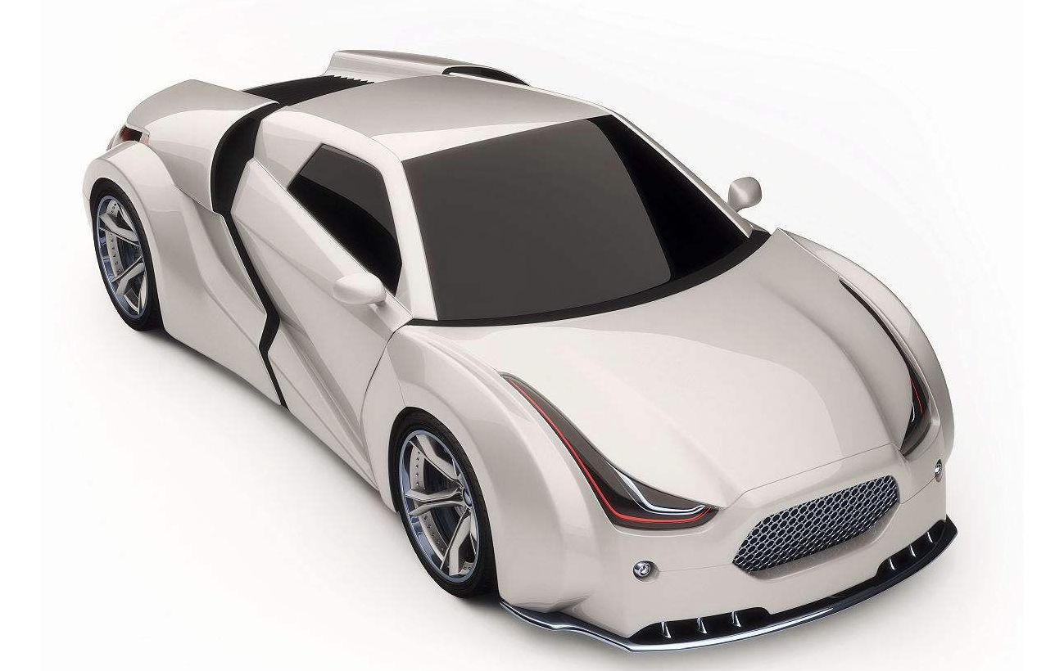
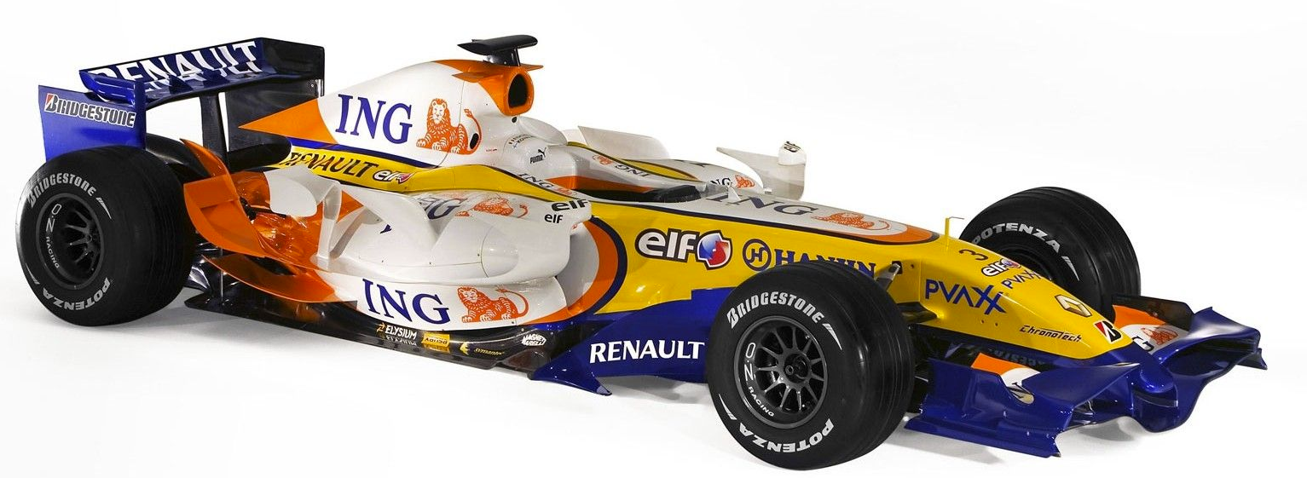
Why TensorRT ?
1.6L Engine

Slide 8
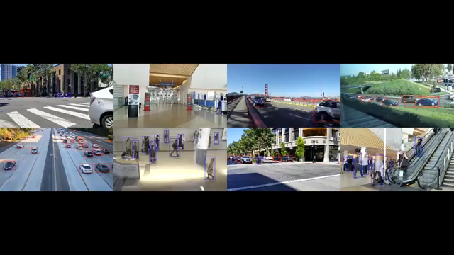
Why TensorRT ?

Slide 9

Why TensorRT ?

Slide 10
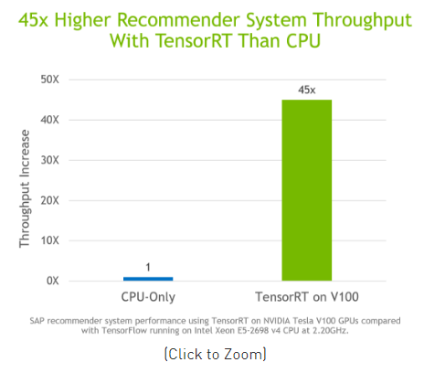
TensorRT
NVIDIA TensorRT™是一种高性能深度学习推理优化器和运行时加速库，可为深度学习推理应用程序提供低延迟和高吞吐量。 使用TensorRT，您可以优化神经网络模型，以高精度校准低精度，最后将模型部署到超大规模数据中心，嵌入式或汽车产品平台。
新编译器加速递归神经网络常用的语音和异常检测
支持超过20个新的ONNX操作，加速关键语音模型，如BERT, TacoTron 2和WaveRNN
扩展了对动态形状的支持，以支持关键的人工智能会话模型
ONNX: Added ConstantOfShape, DequantizeLinear, Equal, Erf, Expand, Greater, GRU, Less, Loop, LRN, LSTM, Not, PRelu, QuantizeLinear, RandomUniform, RandomUniformLike, Range, RNN, Scan, Sqrt, Tile, and Where

Slide 11
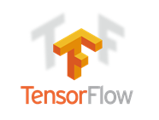
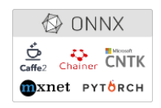

Framework Integrations
NVIDIA works closely with deep learning framework developers to achieve optimized performance for inference on AI platforms using TensorRT. If your training models are in the ONNX format or other popular frameworks such as TensorFlow and MATLAB, there are easy ways for you to import models into TensorRT for inference. Below are few integrations with information on how to get started.

Slide 12
TensorRT: work flow

